Slide 1


TRENDS & RELATIONSHIP BETWEEN AMMONIA AND INTERACTING GASES AND AEROSOLS IN THE UK
YS Tang¹, JN Cape¹, M Twigg¹, C DiMarco¹, E Nemitz¹, WJ Bealey¹, D Leaver¹, J Poskitt², S Beith², S Thacker², I Simmons¹, N van Dijk¹, U Dragosits¹, T Dore¹, L Banin¹, M Vieno¹, D Sleep², MG Pereira², MA Sutton¹, C Conolly³, M Davies³, D Knight², K Vincent³, J Lingard³, M Heal⁴, C Jones⁵, CF Braban¹
¹ CEH Edinburgh, Bush Estate, Penicuik, Midlothian EH26 0QB
² CEH Lancaster, Lancaster Environment Centre, Bailrigg, Lancaster LA1 4AP
³ AEA, Harwell Business Centre, Didcot, Oxon OX11 0QJ
⁴School of Chemistry, University of Edinburgh, West Mains Road. Edinburgh EH9 3JJ
⁵Defra, AQIP, Nobel House, 17 Smith Square, London SW1P 3JR

Slide 2
OUTLINE
UKEAP: overview of component networks
Do concentration data support changes in UK emissions?
  - NAMN: AMMONIA (SEP 1996 - present)
AGANet: ACID GASES & AEROSOL (SEP 1999 - present)

Slide 3
UKEAP
UK Eutrophying & Acidifying atmospheric Pollutants network
OBJECTIVES:
Monitoring of concentrations and deposition of eutrophying and acidifying species in air and precipitation in rural areas of the UK with sufficient spatial and temporal resolution to allow:
• Evaluation of policy measures to reduce concentration and deposition;
• Assessment of risks to ecosystems and exceedances of critical loads;
• Estimation of secondary components of PM_{x}.
Provide UK input to the European Monitoring and Evaluation Programme (http://www.emep.int/).
http://uk-air.defra.gov.uk/
http://pollutantdeposition.defra.gov.uk/ukeap

Slide 4

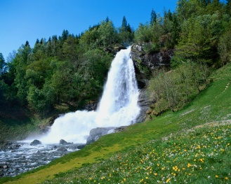
UK Eutrophying & Acidifying Atmospheric Pollutants (UKEAP)
NAMN
AGAnet
NO₂-net
Precip-net
Particles
Wet Deposition
Gases
SO₄²⁻
NO₃⁻
Cl⁻
NH₃
SO₂
HNO₃
NO₂
NH₄⁺
*
*
*
*
*
HCl
Dry Deposition
*
R_{a}
*
*
R_{b}
SO₄²⁻
NO₃⁻
R_{c}
NH₄⁺
Cl-
Notes:
Pollutants monitored by the 4 component networks under UKEAP

Slide 5
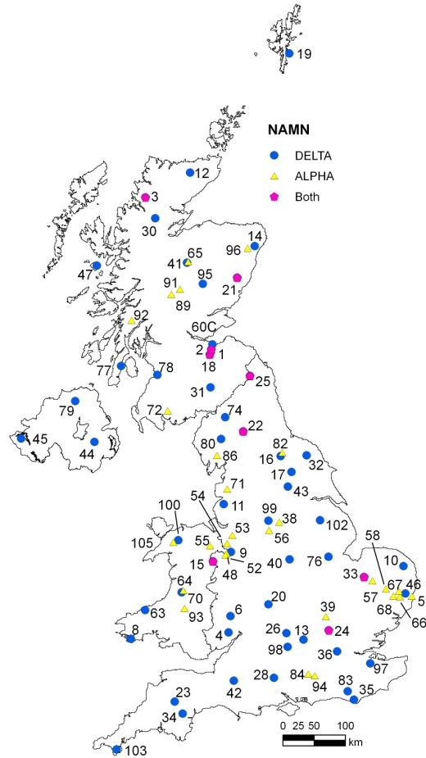
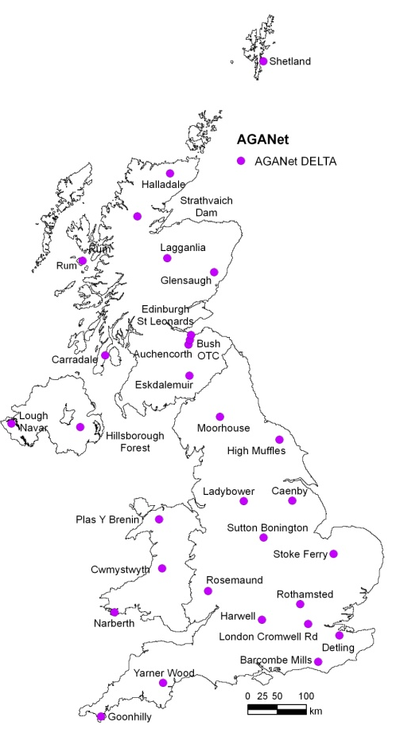
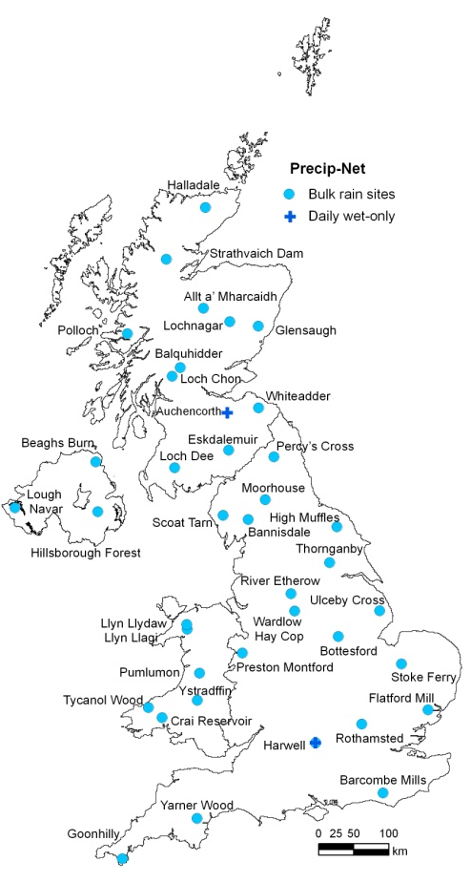
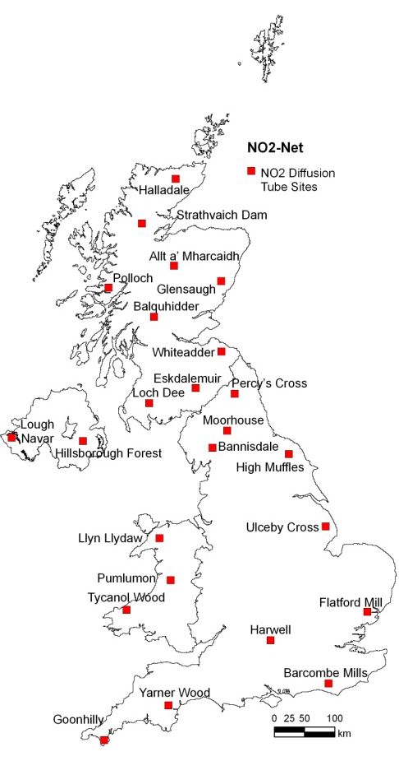
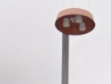
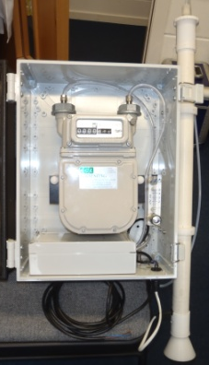
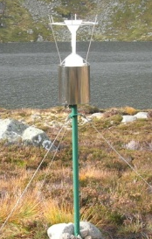
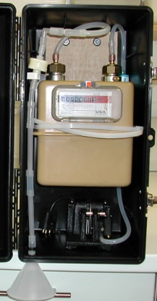
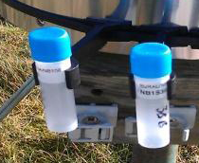
UKEAP component networks
NAMN
85 sites
AGANet
30 sites
Precip-Net
39 sites
NO₂-Net
24 sites
 | NAMN | AGANet | Precip-Net | NO₂-Net
Frequency | Monthly | Monthly | 2-weekly (daily at 2 sites) | 4-weekly
Species | NH₃ NH₄⁺ | HNO₃, SO₂, HCl, NO₃⁻, SO₄²⁻, Cl⁻, Na⁺, Ca²⁺, Mg²⁺ | pH, conductivity, NH₄⁺, NO₃⁻, PO₄³⁻, SO₄²⁻, Cl⁻, Na⁺, K⁺, Ca²⁺, Mg²⁺ | NO₂
Inception | 1996 | 1999 | 1985 | 1984

Slide 6
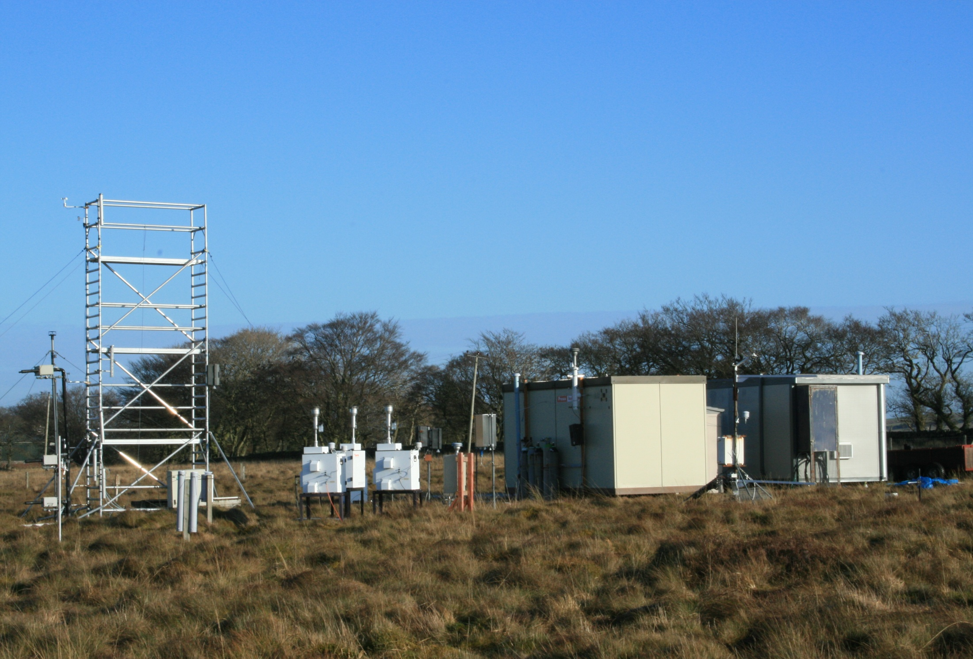
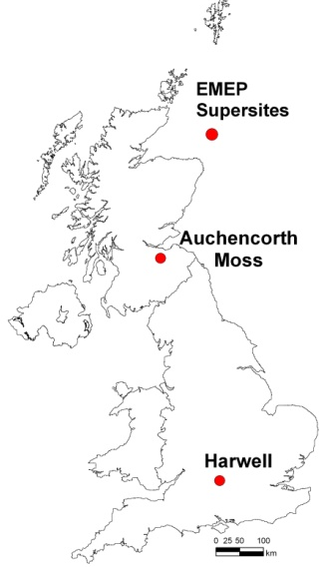
UK EMEP supersites - Auchencorth and Harwell
Measurement | Method
Water-soluble gases + particles at PM2.5 & PM10 | MARGA
Black carbon PM2.5 | Aethalometer
NO/NO2 | Photolytic converter
Meteorology (wind speed, dir’n., temp., RH, precip’n) | Automated met station
Ozone | UV photometer
PM2.5 and PM10 mass (daily) | Filter (gravimetric)
PM2.5 and PM10 mass (hourly) | TEOM/FDMS
PAH (vapour and particle) | Digitel hi-vol
PAH (precipitation) | Bulk sampler
TOMPS (air) | Hi-vol
Hydrocarbons (C₂ – C₈) | Online GC-FID
Particle size and number | SMPS
Mercury (elemental) in air | CVAF
Mercury (speciated) in air | CVAF
Mercury (precipitation) | CVAF
Heavy metals PM10 (air) | ICP-MS
Heavy metals (precip’n) | ICP-MS
Ozone, NOx, SO₂ fluxes | Automated analyzers
Trace gas fluxes | CoTAG
ECOC (weekly) | Filter
Auchencorth, Scotland
http://pollutantdeposition.defra.gov.uk/emep

Slide 7
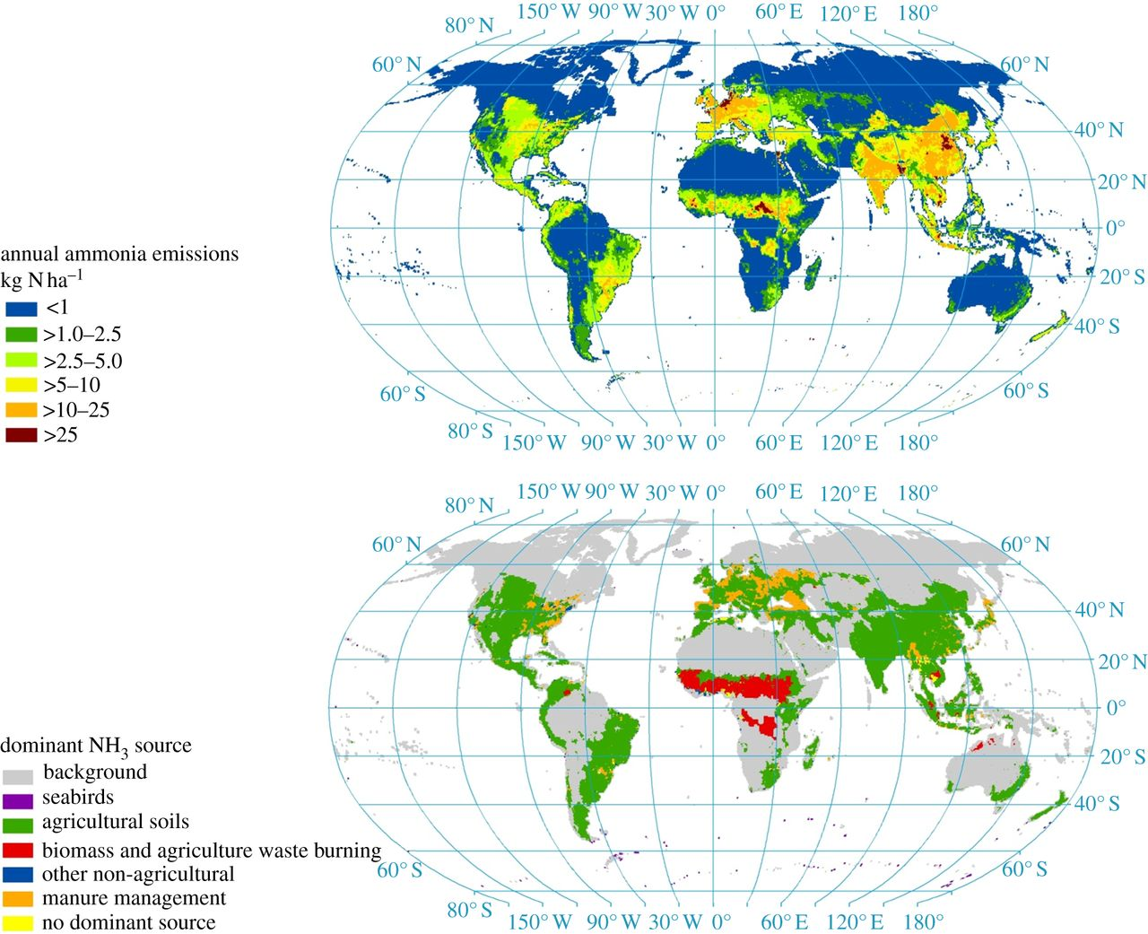
Global NH₃ emissions
Sutton et al. (2013) Philosophical Transactions of the Royal Society (B), 368 (1621)..
Spatial variability in global ammonia emissions based on JRC/PBL (livestock, fertilizers, biomass burning, fuel consumption) and Riddick et al. (seabirds). Emissions from oceans, humans, pets, natural soils and other wild animals are not mapped

Slide 8
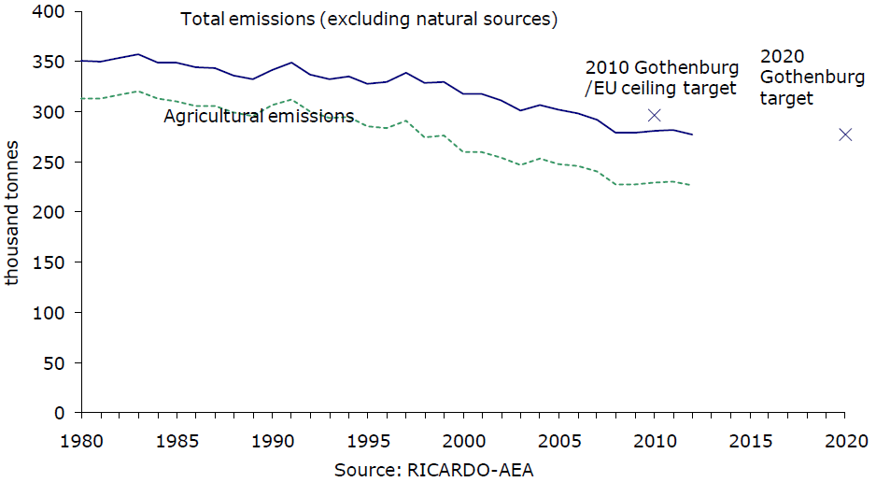
AMMONIA: TRENDS IN EMISSION
NAMN: Sep 1996
Period for comparison
1998 - 2012
www.defra.gov.uk/statistics/environment/
Defra National Statistics Release: Emissions of air pollutants in the UK, 1970 to 2012
Emissions in 2012 represent a decrease of 17 % on the 1998 emissions.
Primary source of NH₃ emissions is from agricultural livestock, and in particular cattle.
Notes:
Primary source of NH₃ emissions is from agricultural livestock, and in particular cattle.
The most significant cause of reductions in recent years has been decreasing cattle, pig & poultry numbers in the UK
Takes us to the next slide: classifiaction of sites for conducting group analysis according to source sector

Slide 9
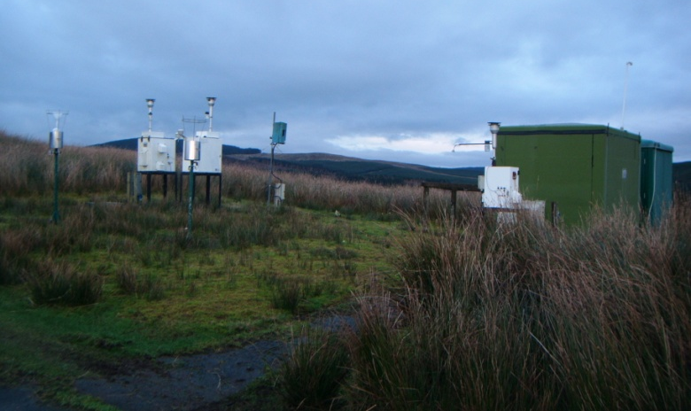
EMEP TIN-TIA data in UK
Comparison of NH_{x} concentrations at Eskdalemuir EMEP station
Eskdalemuir
EMEP values are means of daily measurements for total NH_{x} (sum of NH₃ and aerosol NH₄⁺ by daily filter pack method) matched to the NAMN sampling periods. The NAMN data (Eskdalemuir) are for gaseous NH₃, and for the sum of NH₃ and NH₄⁺. (DELTA method).

Slide 10
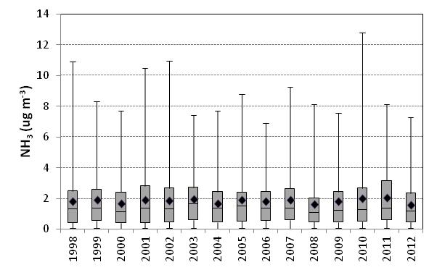
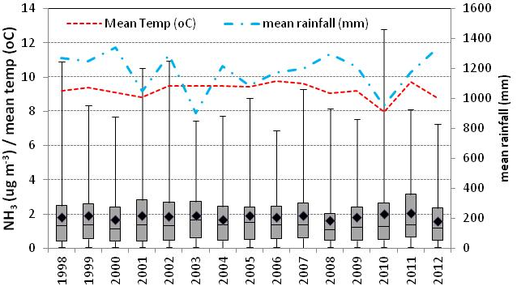
TRENDS IN AMMONIA: ALL DATA
*(N=60)
*(N=67)
(N = 60)
(N = 67)
Changes in atmospheric NH₃ averaged over all sites in NAMN between 1998 and 2012 (N = 75 from 2000, sites with short runs excluded)

Slide 11
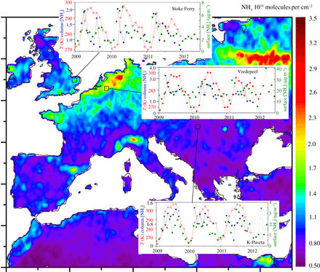
Temperature-dependence of NH₃ emissions
Sutton et al. (2013) Philosophical Transactions of the Royal Society (B), 368 (1621)..
Satellite estimates of the NH₃ column (10⁶ molecules cm⁻²) and ground temperature, showing the mean for 2009, 2010 and 2011 (from the infrared atmospheric sounding interferometer on the MetOp platform), as compared with ground-based measurements of atmospheric NH₃ concentrations at three selected sites

Slide 12
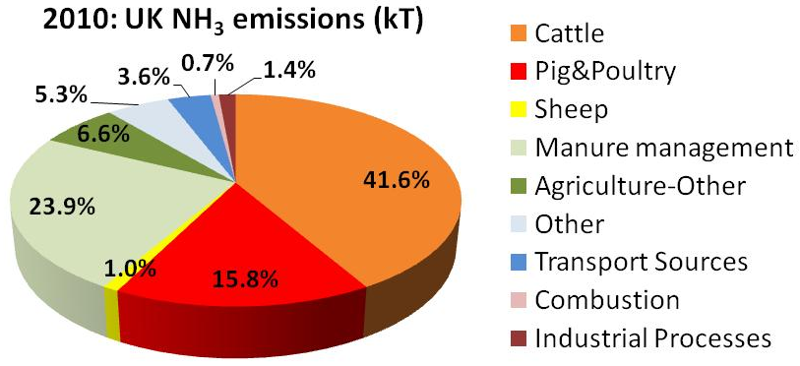
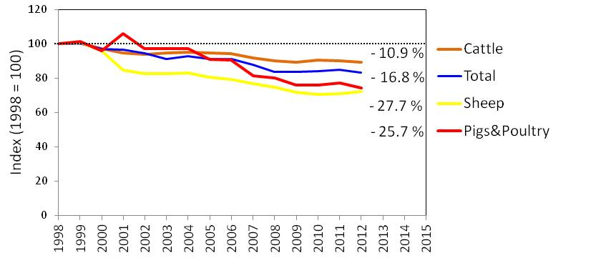
AMMONIA: TRENDS IN EMISSION
The most significant cause of reductions in recent years has been decreasing cattle, pig & poultry numbers in the UK
Data source: http://naei.defra.gov.uk/
Notes:
Primary source of NH₃ emissions is from agricultural livestock, and in particular cattle.
The most significant cause of reductions in recent years has been decreasing cattle, pig & poultry numbers in the UK
Takes us to the next slide: classifiaction of sites for conducting group analysis according to source sector

Slide 13
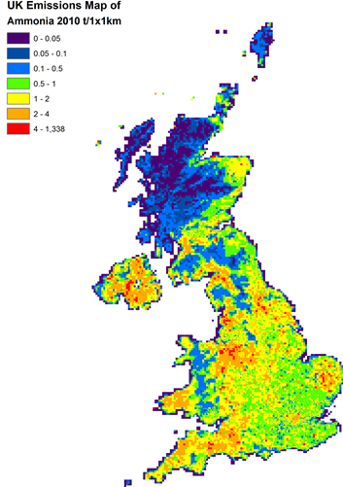
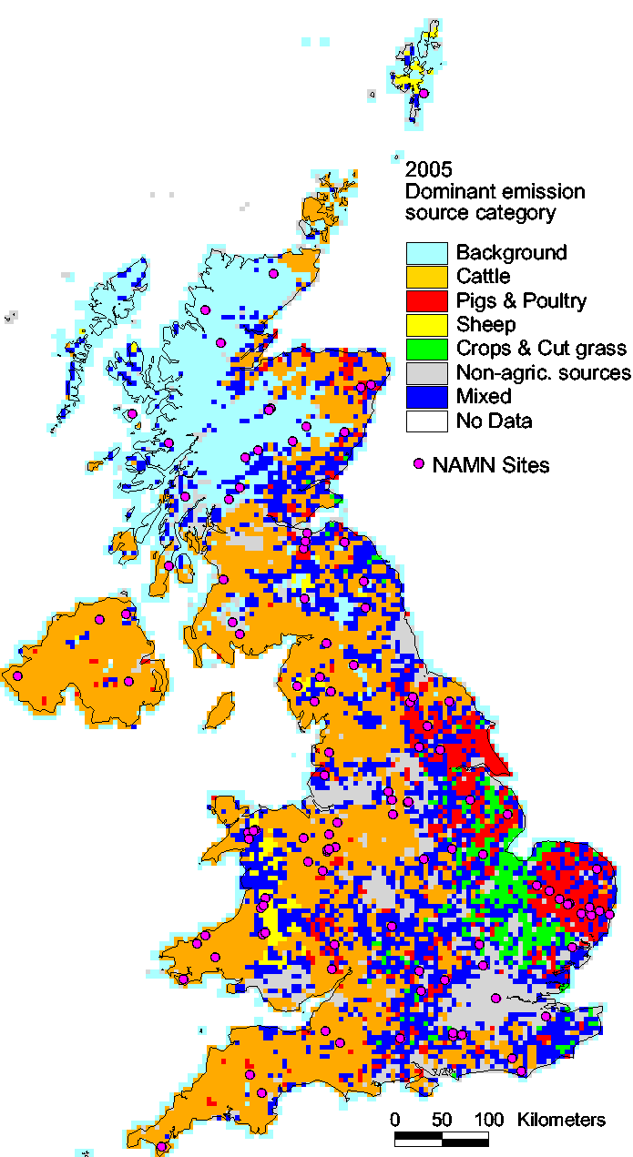
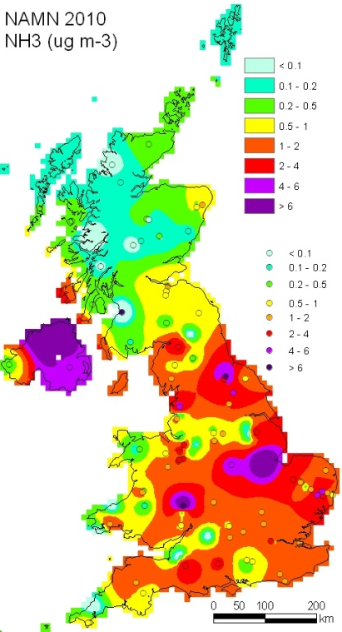
NAMN: TRENDS IN AMMONIA
NH₃ Emissions Map
NH₃ Emission Source Category Map
Interpolated NH₃ Map
http://pollutantdeposition.defra.gov.uk
Dragosits et al., AENEID model
2011 UKEAP Annual Report to Defra
NH₃ temporal trends
NH₄⁺ temporal trends
Notes:
Brief introduction to the 4 component networks

Slide 14
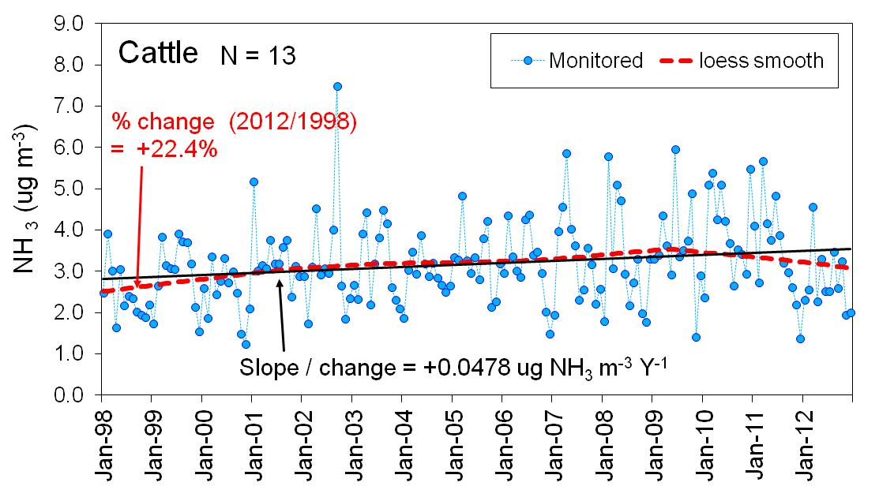
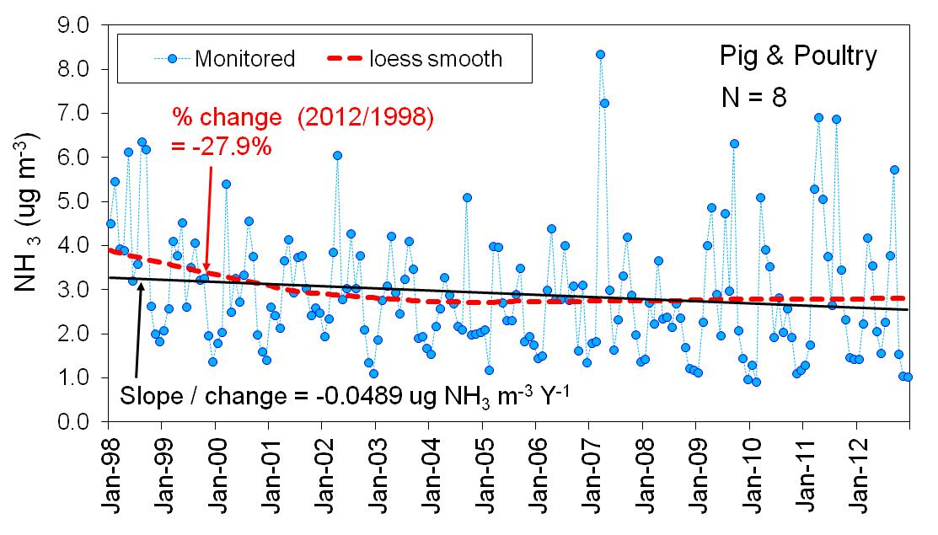
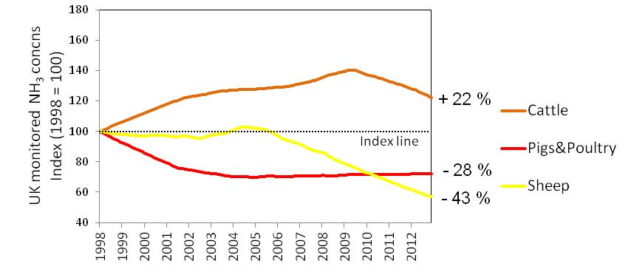
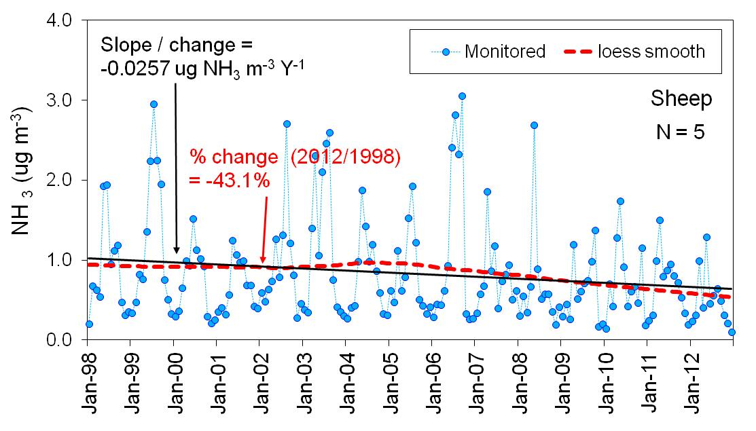
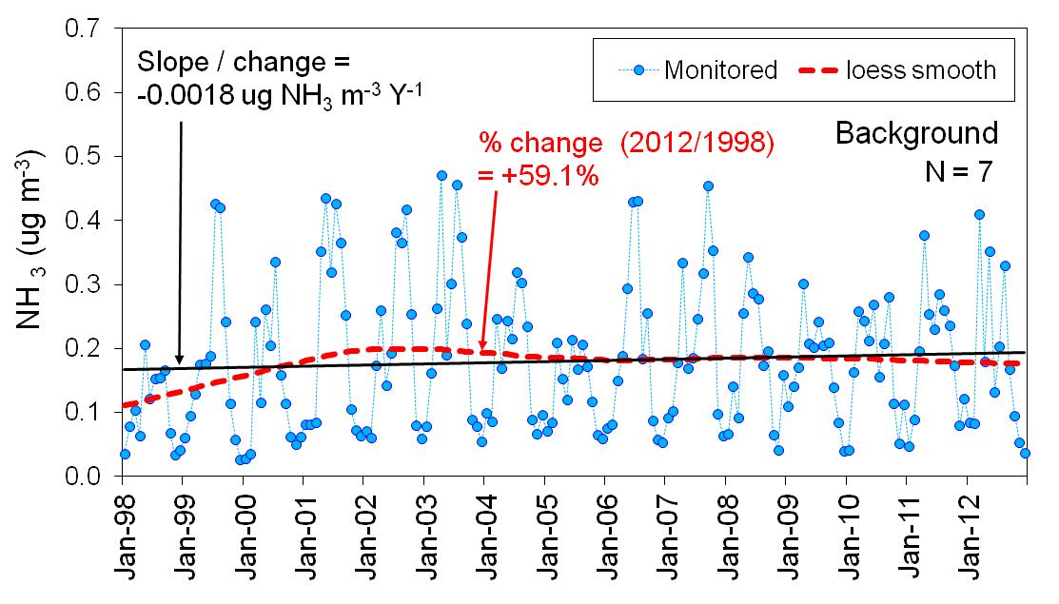
NAMN: TRENDS IN AMMONIA

Slide 15
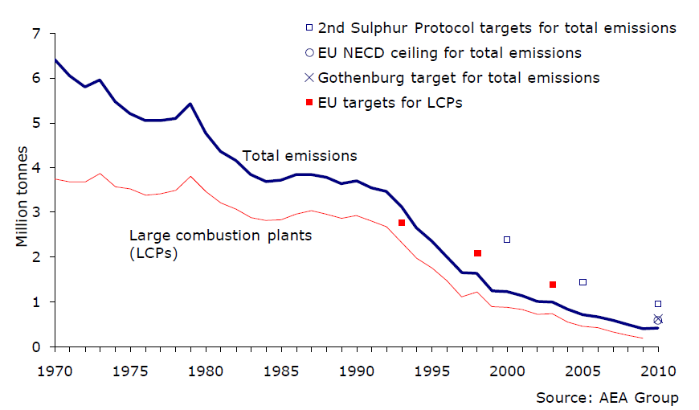
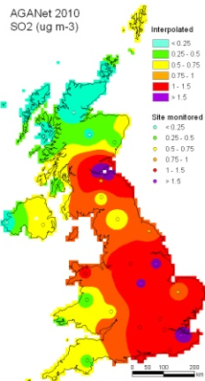
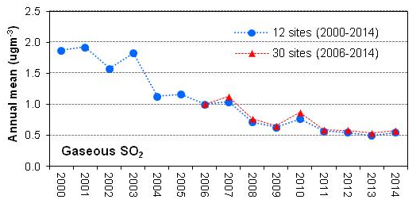
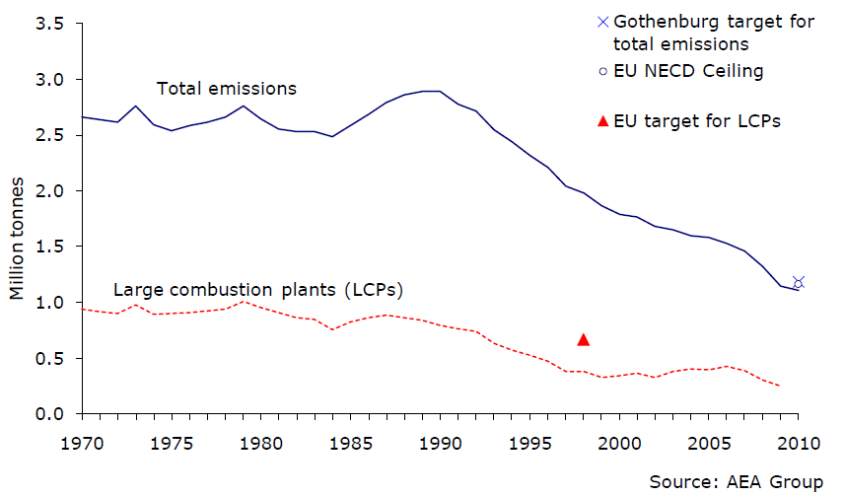
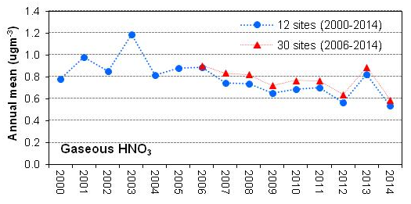
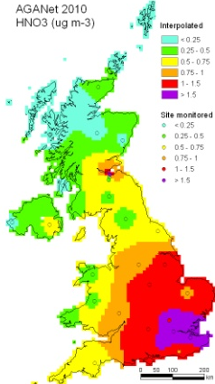
AGANet: TRENDS IN ACID GASES
UK Sulphur dioxide emissions and targets: 1970 – 2010
AGANet measurement data
SO₂
UK Nitrogen oxides emissions and targets: 1970 - 2010
HNO₃
Source: Defra National Statistics Release: Emissions of air pollutants in the UK, 1970 to 2010

Slide 16
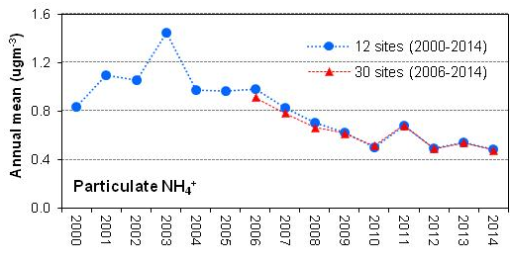
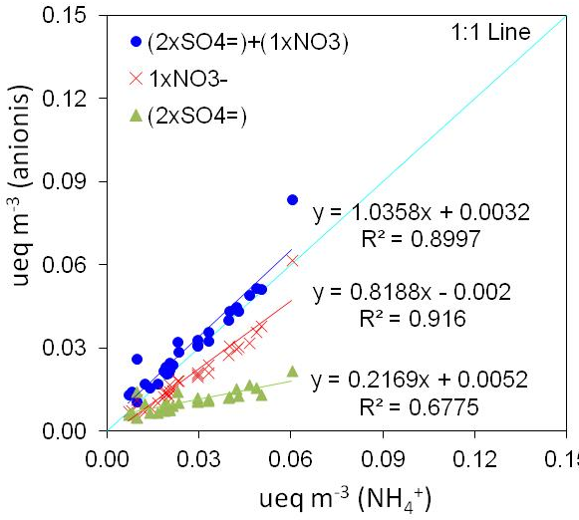
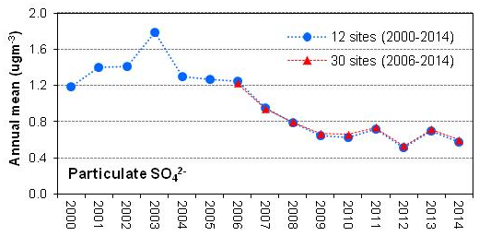
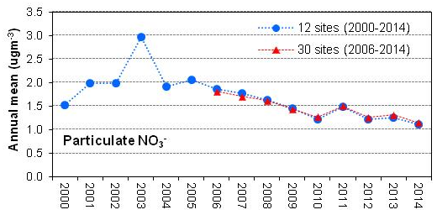
AGANet: TRENDS IN AEROSOLS
Vieno et al. (2014) The role of long range transport & domestic emissions in determining atmospheric SIA conccs across the UK. Atm. Phys. Chem. 14, 1-13

Slide 17
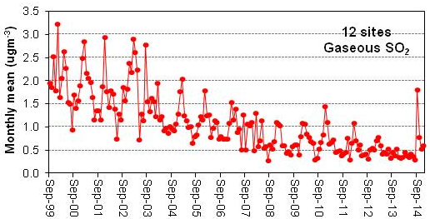
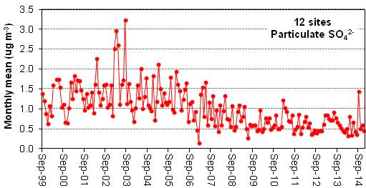
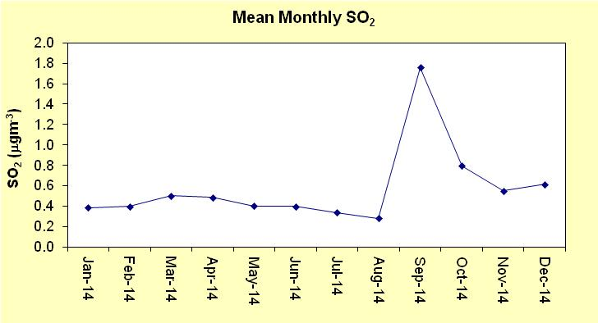
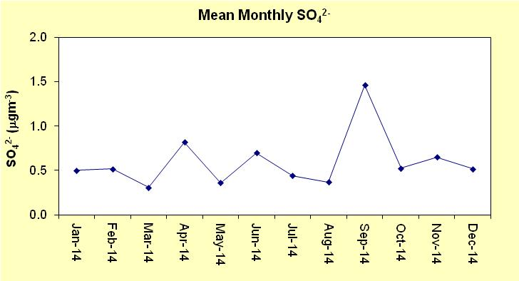
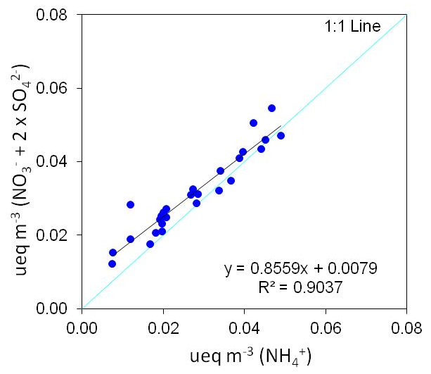
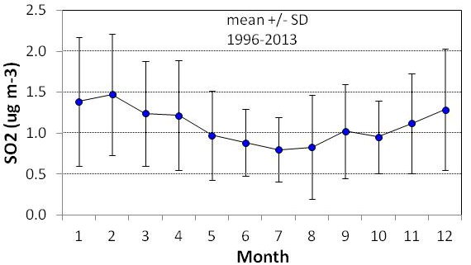
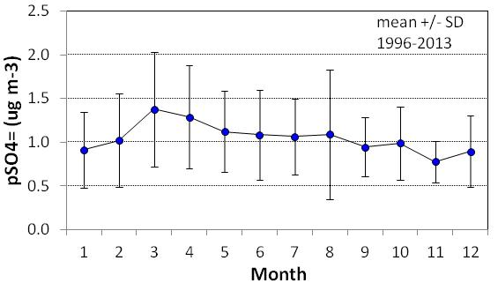
Long range transboundary transport - detecting signal from 2014 volcanic eruption?
2014
2014

Slide 18
SUMMARY
UK NH₃ emissions declined by ~ 17% between 1998 and 2012, but NAMN data showed no significant trend in the whole data set over the same period.
Inter-annual variability influenced by year-to-year changes in rain and temp.
More NH₃ staying within UK due to shift from sulphate ((NH₄)₂SO₄ ~ 20%) to nitrate aerosols (NH₄NO₃ ~ 80%)
In pig and poultry dominated areas, there is a slight but non-significant reduction in NH₃ concentrations, consistent with, but not as large as, the estimated reduction in NH₃ emissions from these sectors (- 26 %).
In cattle dominated areas, there is a slight but non-significant increase in NH₃ concentrations, despite the decline in emissions from this sector since 1998 (-11%).
At background sites, NH₃ concentrations are approximately constant with an indications of an increase.
Non-linearities in relationship between emission and deposition of atmospheric pollutants. e.g. decline in SO₂ is not accompanied by a similar reduction in particulate SO₄²⁻ concentrations..

Slide 19
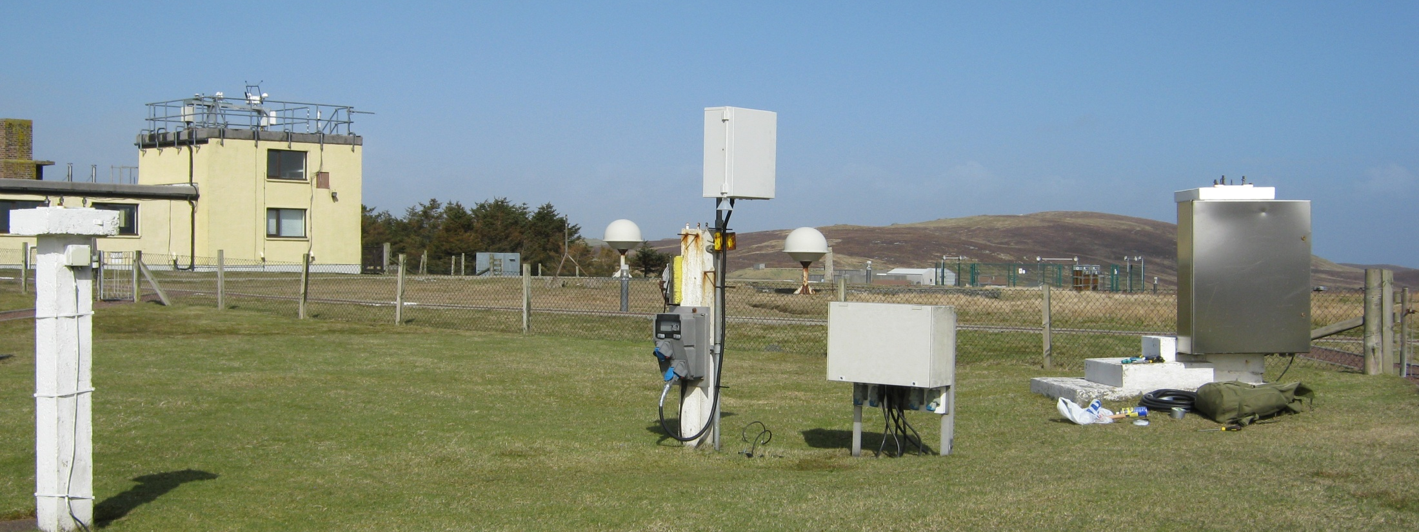
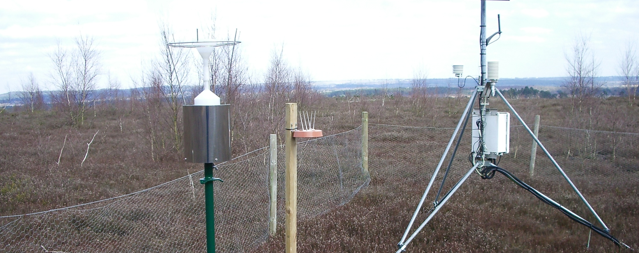

S84B Thursley Common 2
S19 Shetland
ACKNOWLEDGEMENT
DEFRA for funding UKEAP network
UKEAP Local Site Operators
Ricardo-AEA
CEH colleagues
Supporting funds from NERC

